Slide 1

Blackwell strategy: Apple products
October 31st, 2019
Leticia Marcal Russo
Aniss Nigro

Slide 2



Objectives
Analyze Electronidex sales data
Identify insights relative to Apple laptops
Define a strategy to boost Blackwell sales

Slide 3
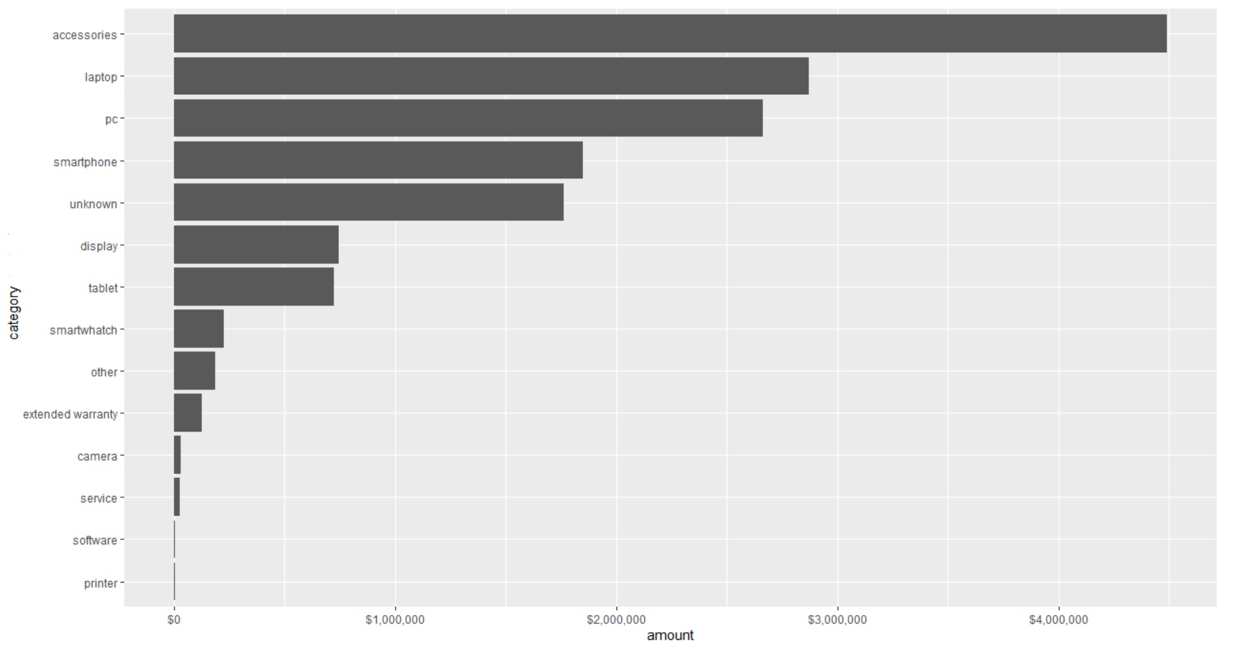
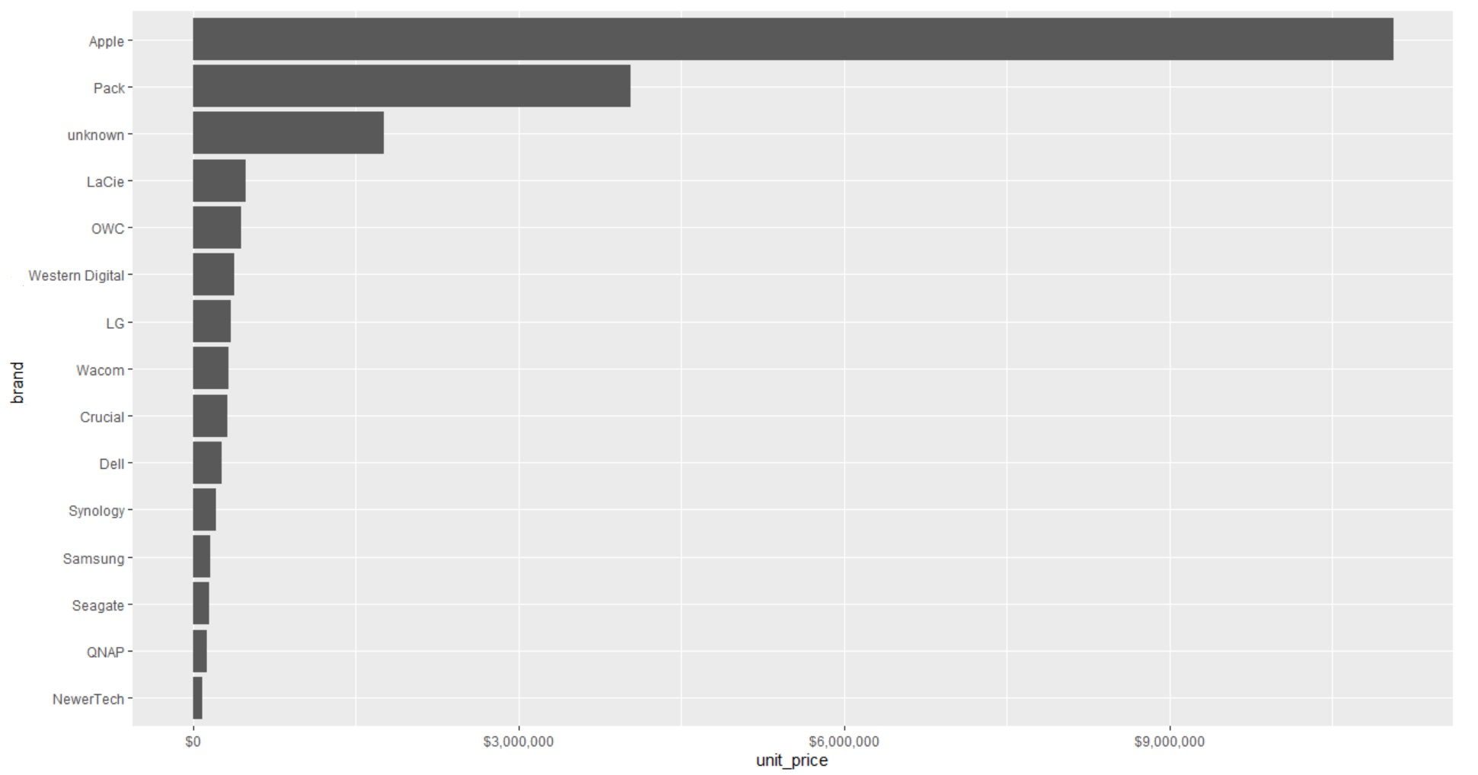
Electronidex sales data

Slide 4
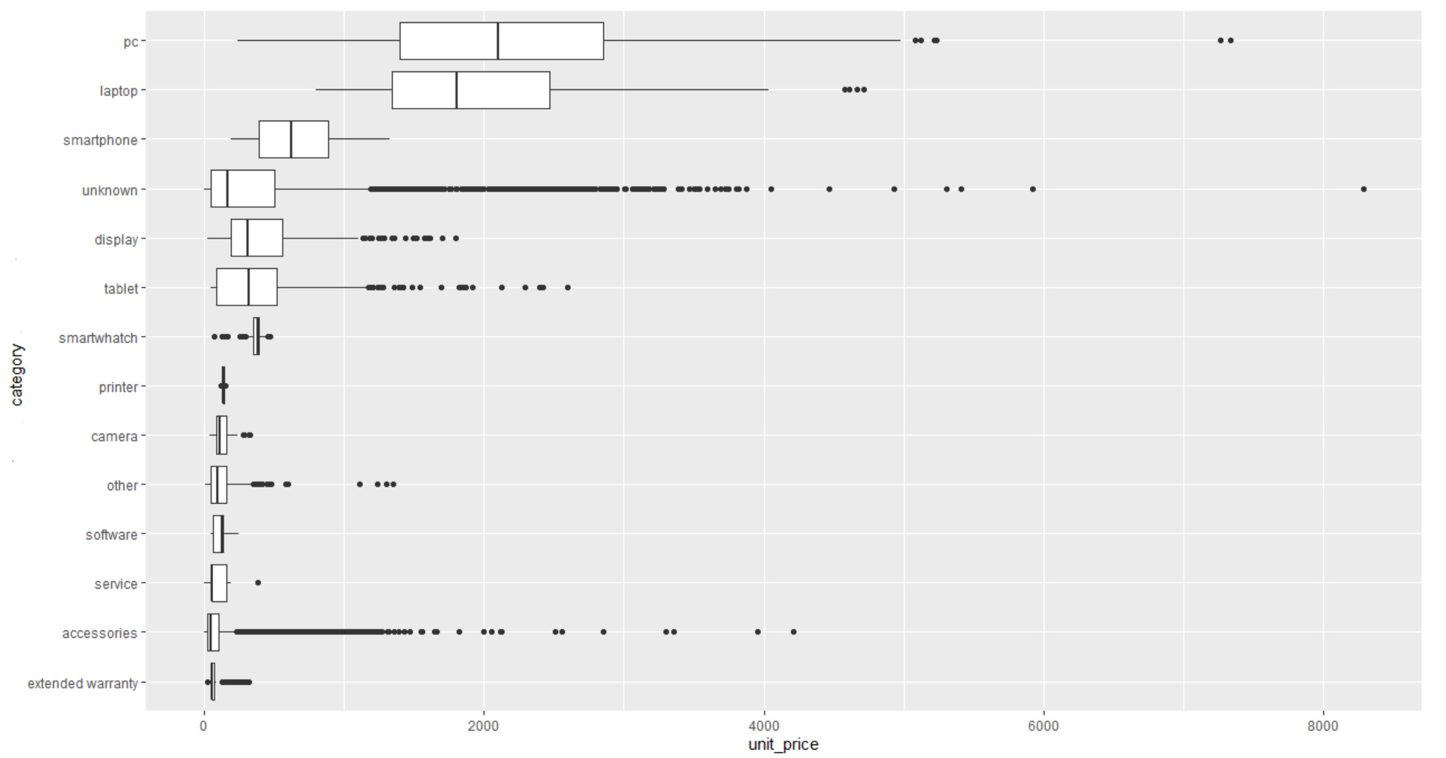
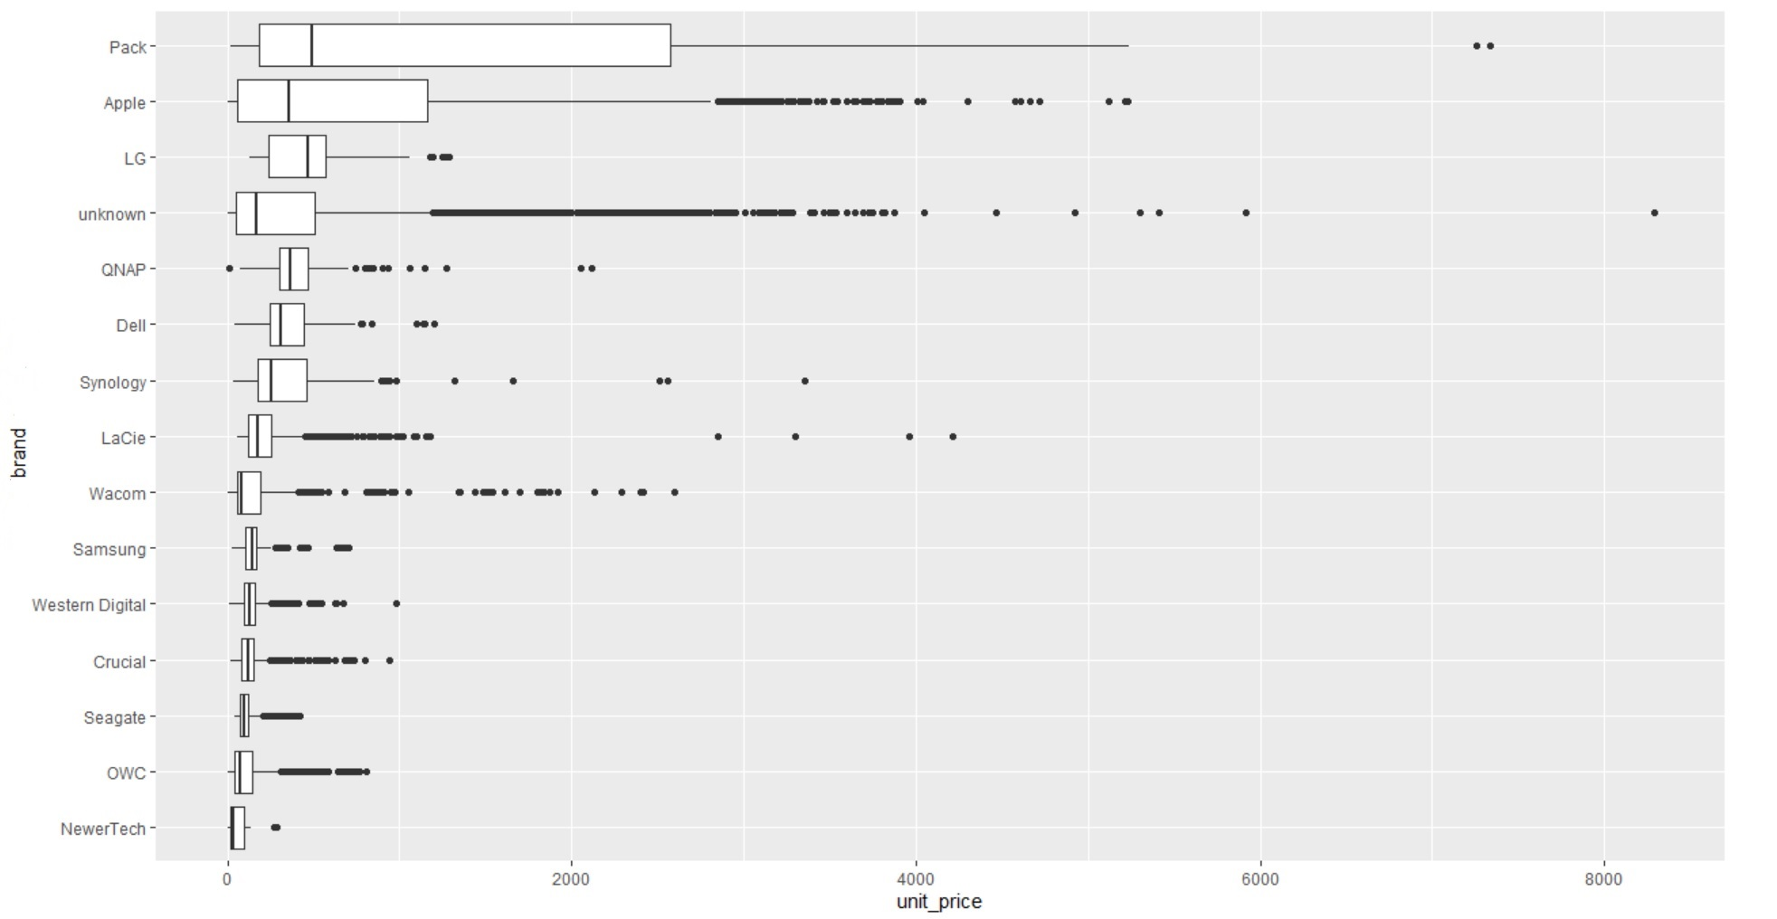
Electronidex sales data
The most bought category is “accessories” but the price distribution is not consistent.
The most interesting categories to focus on are: Laptop, PC, Smartphone, Tablet and Display
We can see that Apple brand is the most frequent (since the company is specialized in this brand)
but other brands are interesting to analyze such as: LG, Dell, Synology and QNAP

Slide 5
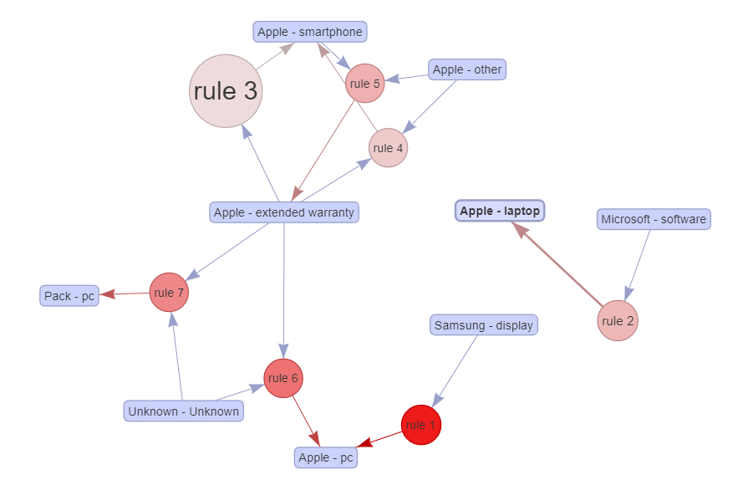
Relationships between Apple laptop and other products
In order to reduce our dataset, we will only analyze the completed “instore” Electronidex sales
Reminder of Blackwell top existing and new products
(out: warranty, accessories, game console)
Patterns in Electronidex sales
ProductType | ProductNum | Price | Profit Margin | Volume | Profitability | Brand
Display | 157 | 1276,57 | 0,25 | 656 | 209357 | Sony
PC | 171 | 699 | 0,25 | 484 | 84579 | Dell
Tablet | 186 | 629 | 0,1 | 1251 | 78688 | Apple
Smartphone | 197 | 499 | 0,1 | 1472 | 73453 | Sony
Tablet | 187 | 199 | 0,2 | 1765 | 70247 | Amazon
Software | 122 | 124,99 | 0,2 | 1576 | 39397
Tablet | 185 | 499 | 0,13 | 592 | 38403 | Sony
Netbook | 180 | 329 | 0,09 | 1273 | 37694 | Acer
Tablet | 188 | 499 | 0,2 | 344 | 34331 | Brother
Display | 156 | 359,99 | 0,2 | 360 | 25919 | Asus
Laptop | 105 | 1079,99 | 0,09 | 232 | 22550 | Brother
PC | 172 | 860 | 0,2 | 120 | 20640 | Dell
Laptop | 173 | 1199 | 0,1 | 156 | 18704 | Apple
Printer | 167 | 149,99 | 0,15 | 824 | 18539 | Sony
Display | 126 | 179,99 | 0,08 | 1224 | 17625 | Canon
We can’t find any consistent pattern relative to Apple laptops.
But we can see an important relationship between Apple extended warranty and other Apple products.

Slide 6
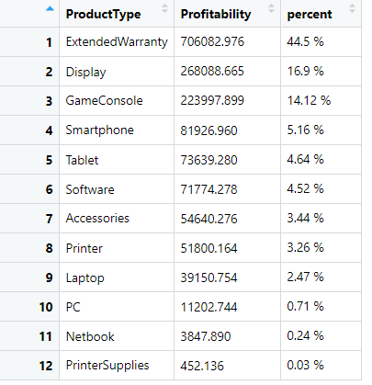
Extended warranty in Blackwell business
Reminder of all Blackwell top existing and new products
Blackwell top profitable product types
ProductType | ProductNum | Price | Profit Margin | Volume | Profitability | Brand
Display | 157 | 1276,57 | 0,25 | 656 | 209357 | Sony
Extended Warranty | 141 | 349,99 | 0,4 | 1232 | 172475
GameConsole | 198 | 129 | 0,18 | 7036 | 163376 | Sony
GameConsole | 307 | 425 | 0,18 | 1553 | 118805
Extended Warranty | 140 | 189,5 | 0,4 | 1232 | 93386
Extended Warranty | 139 | 179,98 | 0,4 | 1232 | 88694
PC | 171 | 699 | 0,25 | 484 | 84579 | Dell
ExtendedWarranty | 138 | 169,98 | 0,4 | 1232 | 83766
Tablet | 186 | 629 | 0,1 | 1251 | 78688 | Apple
Extended Warranty | 137 | 151,98 | 0,4 | 1232 | 74896
Smartphone | 197 | 499 | 0,1 | 1472 | 73453 | Sony
Tablet | 187 | 199 | 0,2 | 1765 | 70247 | Amazon
Extended Warranty | 136 | 134,98 | 0,4 | 1232 | 66518
Extended Warranty | 135 | 129,98 | 0,4 | 1232 | 64054
Extended Warranty | 134 | 124,98 | 0,4 | 1232 | 61590
GameConsole | 200 | 299,99 | 0,12 | 1684 | 60622 | Microsoft
Software | 122 | 124,99 | 0,2 | 1576 | 39397
Tablet | 185 | 499 | 0,13 | 592 | 38403 | Sony
Netbook | 180 | 329 | 0,09 | 1273 | 37694 | Acer
“Extended Warranty” is the most profitable product type for Blackwell.
“Apple extended warranty” could be profitable for Blackwell business but it can not be launched by itself.
According to Electronidex data, the best products to sell with the “Apple extended warranty” are: Apple smartphones and Apple laptop (in Packs)

Slide 7
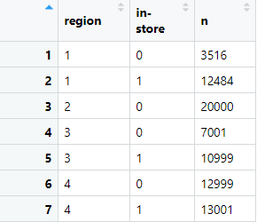
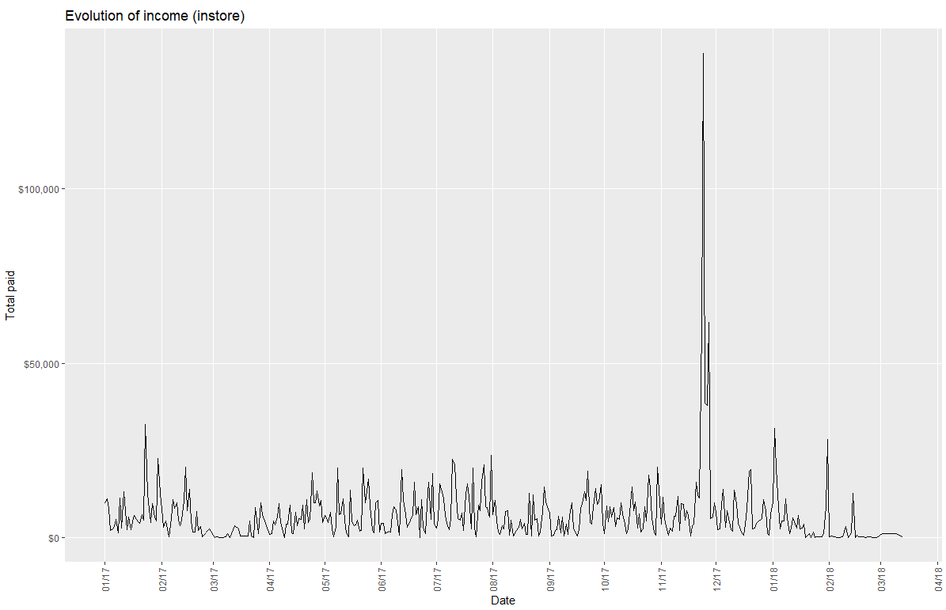
Launch of Apple products in test stores
The Electronidex data does not give us enough insights to define a global strategy
but we can launch the following products in some stores to test the success:
Apple smartphone
Apple tablet
Apple laptop
Apple extended warranty
Repartition of Blackwell purchases per region and channel
Blackwell customer types per region
Evolution Electronidex instore sales
East [1] | West [2] | South [3] | Central [4]
Persona 1 Purchasing in-store Amount per t. < 1000€ Age > 63 years old Persona 2 Purchasing in-store Amount per t. < 2000€ Age < 63 years old | Persona 1 Purchasing online Amount per t. < 1000€ Age > 29 years old | Persona 1 Purchasing in-store Amount per t. < 1000€ Age > 63 years old Persona 2 Purchasing online + in-store Amount per t. not limited Age < 63 years old | Persona 1 Purchasing online + in-store Amount per t. not limited Age < 52 years old Persona 2 Purchasing online Amount per t. not limited Age > 52 years old

Slide 8



Conclusion
Electronidex data is not sufficient to define a strong strategy about Apple laptops
But we can test Apple products in some stores and then launch them globally if the results are positive
Products :
Apple smartphone
Apple tablet
Apple laptop
Apple extended warranty
Location :
Region 4
Time:
End of November
(Black Friday)

